Slide 1
Securing Ghana Police Data Communication
Course Title: Certified Cybersecurity Technician (C|CT)
Institution: IPMC
Student Name: Tymon Kofi Ansah-Antwi

Slide 2
Executive Summary
This project is about keeping Ghana Police information safe when it is shared between the main office in Accra and the regional offices.
It makes sure that police officers can use their work systems safely, whether they are in the office or using their devices.
The project helps prevent information from being stolen, lost, or used by the wrong people.
It also sets clear rules to guide staff on how to handle information properly.

Slide 3
Project Scope
Keeping data safe when it is stored or shared between main office in accra and 16 regional offices.
Police officers to be safely connected to the system
Ensuring only the right staff can use the system.
A network topology that shows how offices and devices are connected securely.

Slide 4
Network Security Requirements
Keeping data private with the use of encryption (Confidential).
Stop changes by outsiders with the use of digital signatures (Integrity).
Always be working with the use of backup solutions (Availability).
Only staff can log in with the use of passwords and MFAs (Authentication).

Slide 5
Possible Network Security Issues
Unauthorized access to sensitive databases.
Insider threats from staff with excessive privileges.
Weak or reused passwords leading to breaches.
Outdated software and no antivirus enabled
Data interception and exposure during transmission or storage

Slide 6
Security Mitigation Plan/Security Controls
Use VPNs and MFA for secure remote access.
Apply role-based access so staff can see the data they need
Implement a strong password policy with MFA enforcement
Maintain regular updates and a clear incident response plan. Apply firewalls, IDS/IPS, and endpoint protection.
Encrypt all data in storage and during transfer.

Slide 7
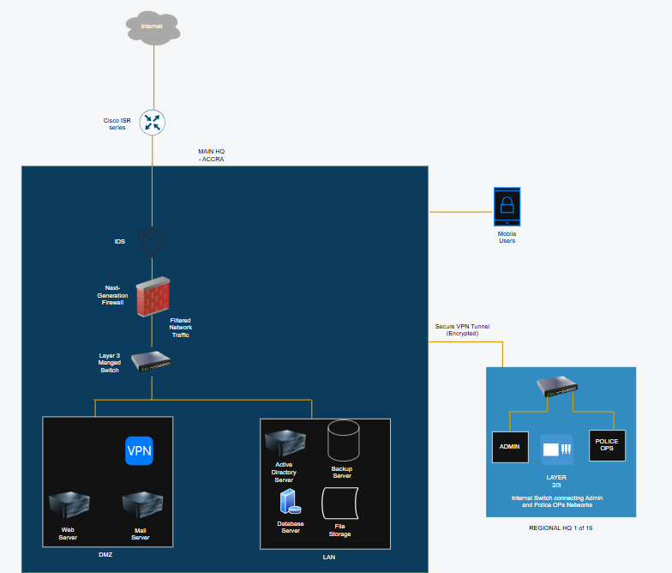
Network Security Diagram

Slide 8
Data Protection Issues
Exposure or misuse of sensitive police data.
Unauthorized access from outsiders or insiders.
Replication errors across regional databases.
Ransomware threats and weak backup systems.

Slide 9
Data Protection Security Controls
Encrypt and control access to personal data.
Enforce MFA, firewalls, and regular audits.
Use database integrity checks across all regions.
Keep secure, encrypted backups offline and online.

Slide 10
User & Device Authentication Controls
Use MFA and strong passwords for staff using the active directory (Password Policy Enforcement)
Apply role-based access and account monitoring using the Active Directory (Role Assignment and Group Policies)
Secure devices with digital certificates and MDM with the use of Group Policy via Active Directory (Device Security Enforcement)
Ensure all police devices are encrypted and trusted with the user of bitlocker

Slide 11
Security Policies
Password Management Policy - This policy ensures strong and secure password use.
Mobile Device Policy - This policy ensures secure use of the police smartphones, tablets and laptops.
User Account Management Policy - This policy ensures the rules for creating and managing user accounts.
Incident Response Policy -This policy shows how to encounter cyber attacks.
Data Protection Policy -This policy protects sensitive police data.

Slide 12
Conclusion
1. This project presents a secure communication framework for Ghana Police Service
2. It identifies key network and data security risks
3. Practical security controls are proposed to reduce vulnerabilities
4. Strong authentication, encryption, and monitoring strengthen system protection
5. Policies and technical measures together ensure long-term security and resilience

